Slide 1
Produt size and Shape Evaluator Using Vision Intelligent Systems
SIMATS ENGINEERING
Saveetha Institute of Medical and Technical Sciences
Chennai-602105.
M.kousik reddy(192425185)
M. Phanith Chandu(192425238)
T. Bhanu Pavan Varma(192425380)
M. Harinath(192425020)
U.Chenna kesava reddy(192425206)
Supervisor
Dr M. Prakash,
Dr Logu,
SIMATS Engineering

Slide 2
Introduction
In industries, checking the size and shape of products is important to maintain quality.
Manual inspection takes more time and may cause errors.
This project uses a camera and image processing to automatically evaluate products.
The system captures an image and measures dimensions and detects shape.
It helps to identify defective or incorrect products quickly.
This method is fast, accurate, and useful for quality control in manufacturing industries.

Slide 3
Problem Statement
In many industries, product inspection is done manually, which is time-consuming and less accurate.
Human inspection may lead to errors in measuring size and identifying shapes.
There is a need for a system that can automatically measure product dimensions with good accuracy.
Industries require a solution to quickly detect defective or incorrectly shaped products.
Therefore, a vision-based intelligent system is needed to automate product size and shape evaluation efficiently and reliably.

Slide 4
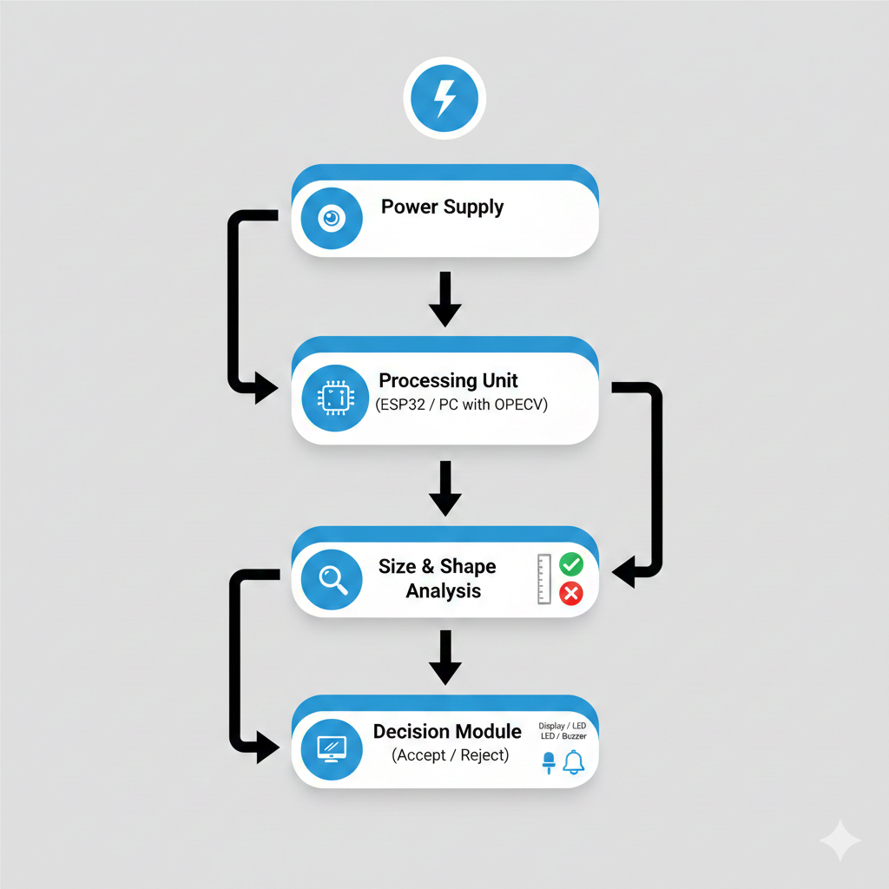
System Architecture / Workflow
A camera module captures the image of the product placed on the platform.
The processing unit (ESP32 or computer) processes the image using image processing techniques.
The system detects the shape and measures the size of the product.
The result is displayed on an LCD or indicated using LED/Buzzer as Accept or Reject.

Slide 5
Module 1: Image Acquisition Module
This module captures the image of the product.
A camera or ESP32-CAM is used to take pictures.
The product is placed on a fixed platform.
The image is captured when the product is detected.
The captured image is sent to the processing unit.

Slide 6
Module 2: Image Pre-Processing Module
This module prepares the image for analysis.
The image is converted to grayscale.
Noise and unwanted details are removed.
Edges of the object are detected.
The processed image is sent for shape detection.

Slide 7
Module 3: Shape Detection Module
This module identifies the shape of the product.
It detects the boundary (contours) of the object.
The number of sides is calculated.
Shapes like circle, square, or rectangle are recognized.
The detected shape is passed to the next module.

Slide 8
Module 4: Size Measurement Module
This module measures the size of the product.
Object dimensions are calculated in pixels.
Pixels are converted into real units (cm).
The measured size is compared with standard values.
The result is sent to the decision module.

Slide 9
Module 5: Display and Decision Module
This module decides whether the product is acceptable or not.
Size and shape results are displayed.
Accept or Reject status is shown.
LED or buzzer can be used for indication.
The final inspection result is provided to the user.

Slide 10


